Slide 1
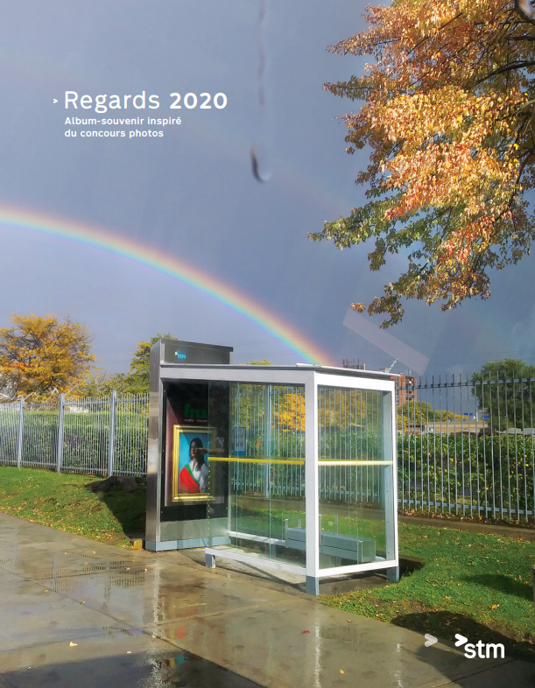
Note: Album published in French only
Title: 2020 Visions: A keepsake album inspired by our photo contest
Envelope: 2020 Visions: A gift to help you look back on a memorable year

Slide 2
Comments on the keepsake photo album
I received my photo album… it’s fantastic!! Amazing work. Very beautiful and touching, thank you! Stéphanie Courtemanche
It was so wonderful to receive my photo album at home! So emotional, it’s crazy. It’s a beautiful thing and a gift I’m sure everyone will love. Lydia Krause
What a fantastic idea you had! Thank you. I LOVED receiving this photo album. I even got a little emotional flipping through it. Marie-Hélène Plourde
Thank you for the photo album. I was astonished by the quality and the talented employees in all these departments. I’m going to keep this album safe in my keepsake box and when the time comes to tell my grandchildren about 2020, I’ll be able to show them what we went through. Guy Foster
What a lovely idea. I just went through it and it was very emotional. Philippe Schnobb, Chairman of the Board of Directors
I just wanted to thank you for the photo album. It’s a really nice keepsake! Annie Julien
I was very moved. It’s the nicest gift I’ve ever received from the STM! David Bombardier
I just received my gift, and wow! What a great idea. I’m really glad to have this keepsake. Marie-Claude Sirard
I took the time to look at each photo and appreciate it. It really spoke to me to see the métro so empty and nature reclaiming the space. Really beautiful. Barbara Mailhot
A really beautiful document that represents all areas of the company. Denis Lecours

Slide 3
Major milestones

End of photo contest
October 16
Selection committee
Album mailout
December 8

October 22
End-of-year webcast
December 14
September
October
November
December
Photo contest launch
Keepsake album creation


November 2 to 27
September 14

Slide 4
Order of communications
Photo contest launch
September 14
End of photo contest
Keepsake album project reveal
Distribution
October 16
September
October
November
December
Facebook groups – Sep 14
Contest reminder on Facebook groups – Oct 1
Facebook groups – Nov 17
Intranet/internal Facebook groups: mailout announcement – Dec 9
Zone Gestionnaires – Sep 14
Info to ExCo – Oct 5
Intranet/COVID-19 extranet/e-newsletter/screens: winners – Nov 18
Info to extended management committee – Oct 6
End-of-year webcast: presentation of selected negatives – Dec 14
Intranet/COVID-19 extranet/e-newsletter/screens – Sep 15
Intranet: album project announcement – Nov 25
Workplace signage (operational + some active corporate areas) – from Sep 21
Intranet/COVID-19 extranet/e-newsletter/screens reminder – Oct 6 and 13
Intranet/internal Facebook groups: cover reveal video with driver – Dec 17
Digital employee portal (info message) – from Sep 22
Contest mentioned during CEO webcast – Oct 8
Zone Gestionnaires end-of-year activity announcement – Oct 31
En Commun
Electronic – Sep 22
Personalized friendly messages – week of Sep 28

