Slide 1
APTA AdWheel 2022 Submission Siemens Mobility #AmericanMade Communications Plan
Assets and deliverables

Slide 2
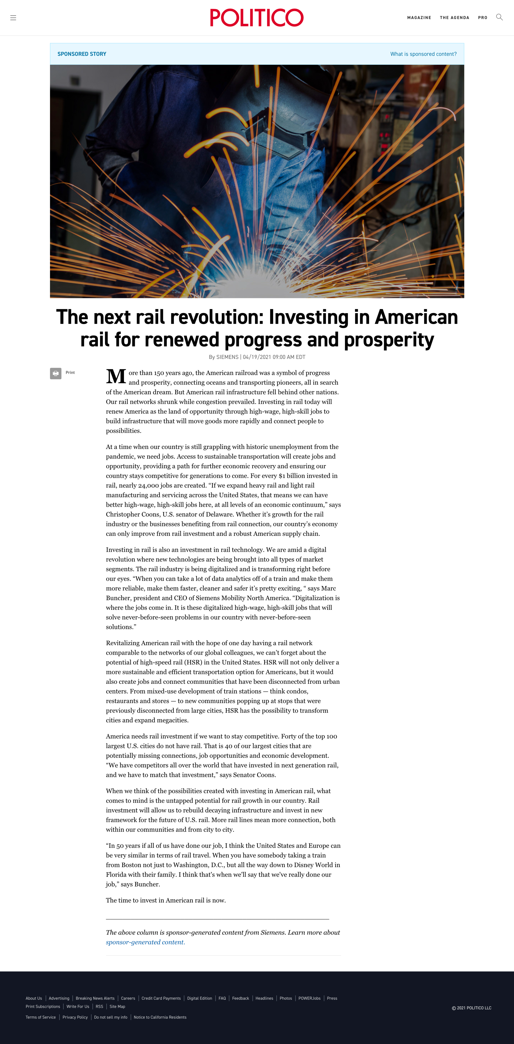
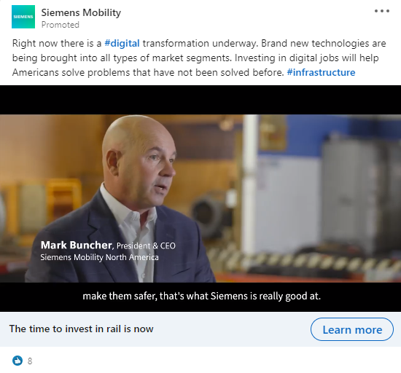
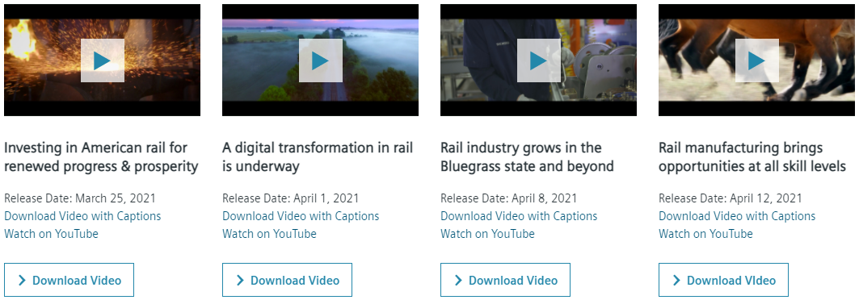
The $3 Trillion Dollar Opportunity: Biden’s Infrastructure Bill
5.1K article views
Above industry avg. time spent on page = 00:03:26
The Goal
Support for $3 trillion-dollar U.S. infrastructure spending package on rail funding, sustainability, & jobs
Grow rail investment and set up our industry for future funding
Highlight suppliers and economic benefits to build bipartisan support
34 SoMe posts
1.2K Likes
4K YouTube views
2.4 Million Impressions
The 360°Campaign
Keystone 4-part video series
Amplify voice of our employees
Advertising: Targeted. Data-driven. Social. Programmatic. Advertorial.
Organic engagement: Social media. Industry associations. GA.
Web landing page & Media toolkit
Industry coverage: Railway Age, Progressive Railroading, Mass Transit, RSI Newsletter, North American newsletter
LinkedIn Banners & Teams Backgrounds
300+ downloads
Webpage &
Media Toolkit
00:04:19 avg. time spent on page
Notes:
Updated June 8

Slide 3
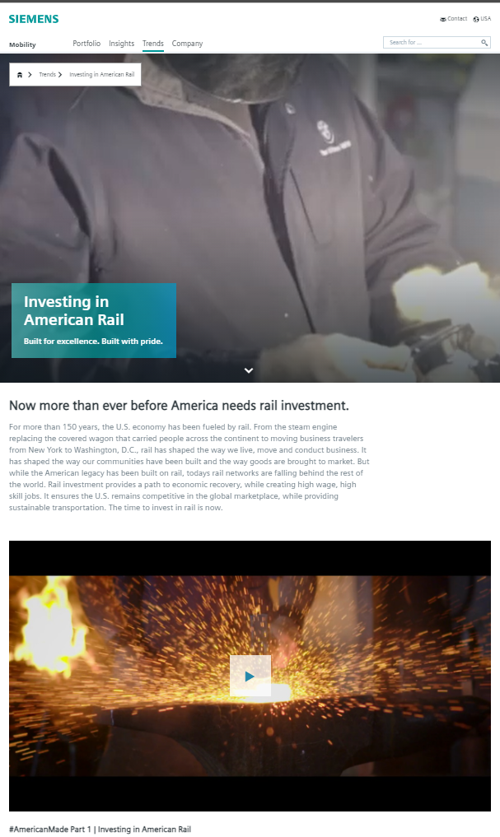
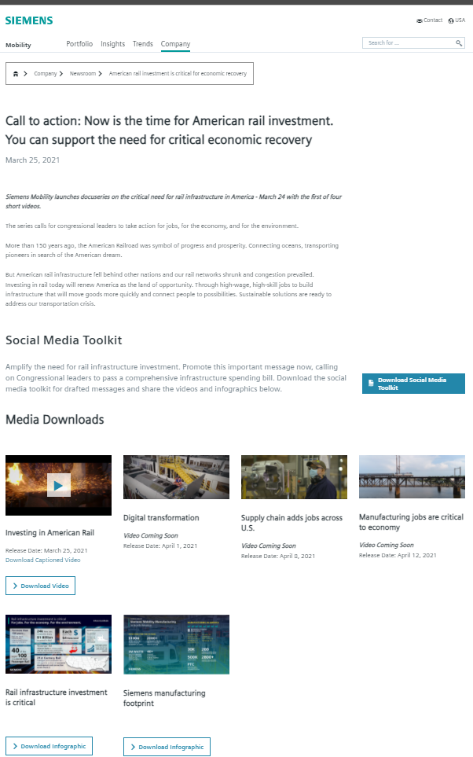
Owned Media
Investing in American Rail webpage
Press Page –
call to action
Webpage &
Media Toolkit
00:04:19 avg. time spent on page
Notes:
Updated by Vanessa – June 1 – date range for data – March 25-May 26

Slide 4
Organic Social Media
34 Social posts
1.2K Likes
4K YouTube views
Notes:
Updated by Vanessa – June 1 – just added total Video completes
Updated by Vanessa – June 1
- Tracked traffic from our LinkedIn efforts generated 17.8% of all tracked campaign traffic and 15.4% of all tracked on site video views – total tracked time spent on site from our LinkedIn efforts was nearly 6 minutes.

Slide 5
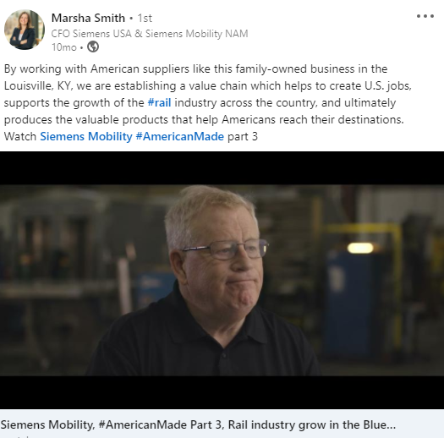
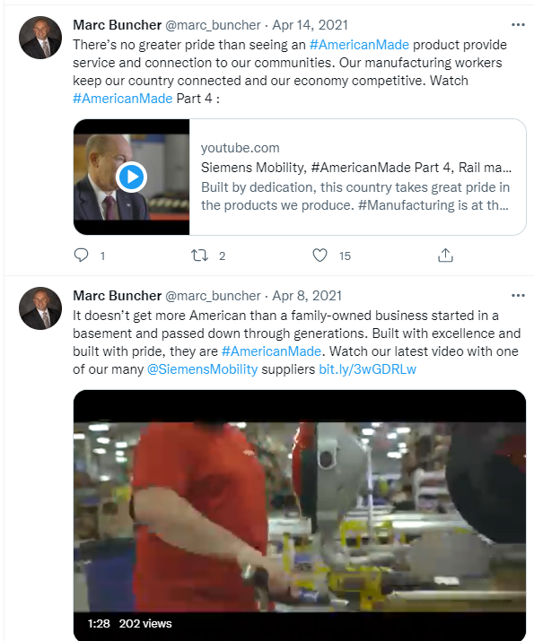
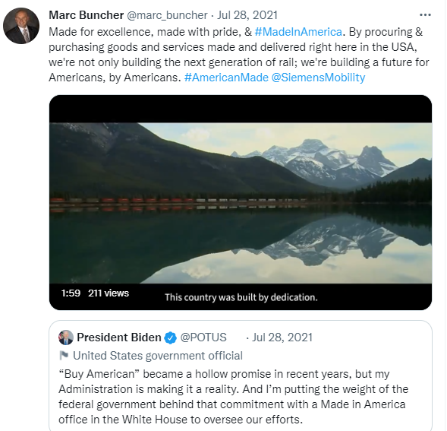
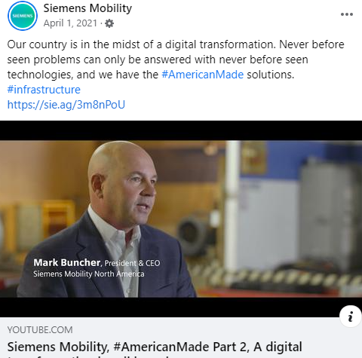
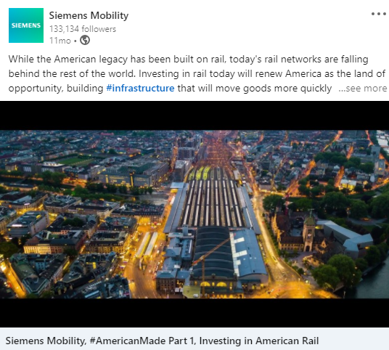
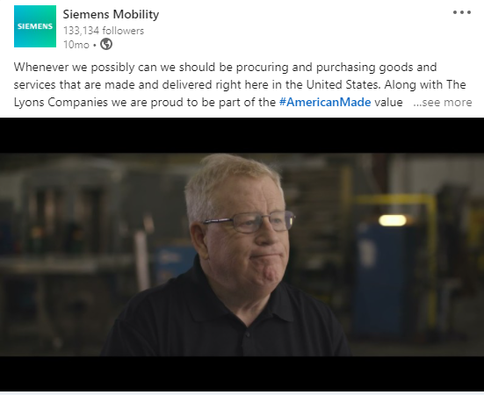
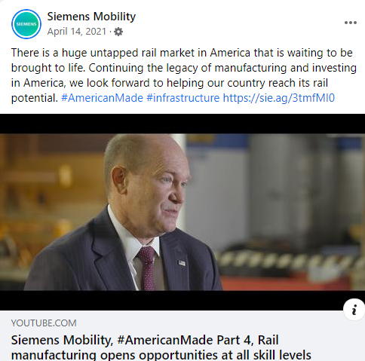
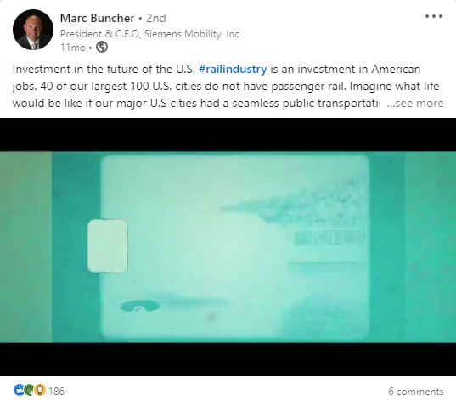
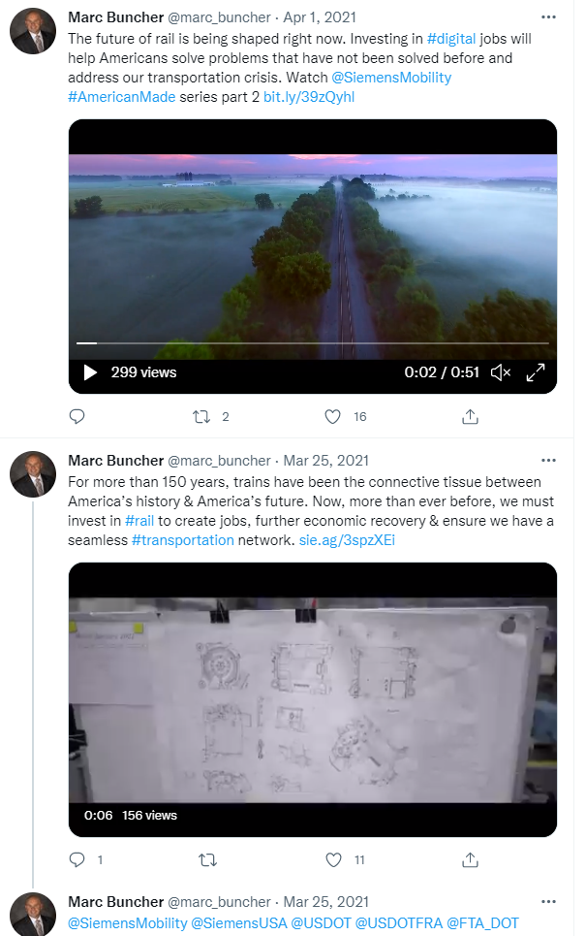
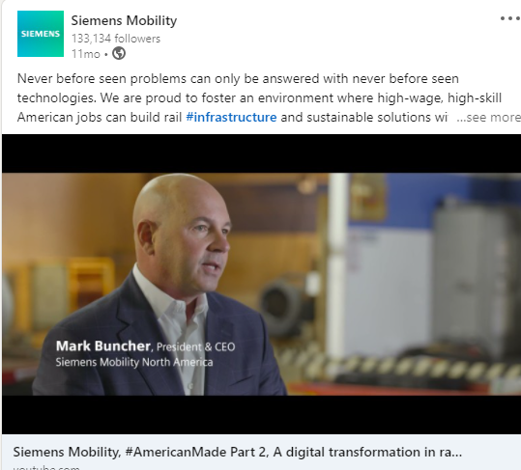
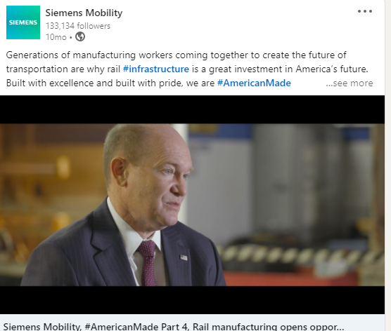
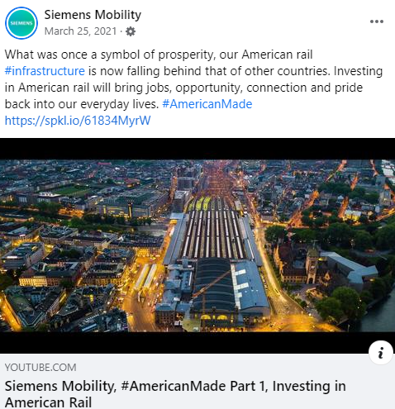
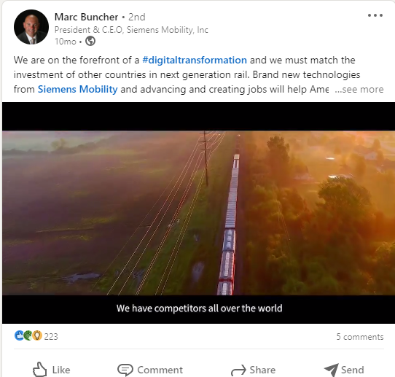
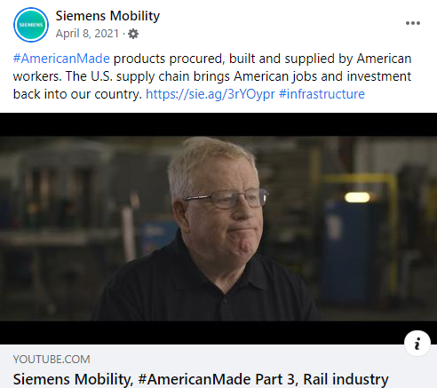
Organic Social Media
34 Social posts
1.2K Likes
4K YouTube views
Notes:
Updated by Vanessa – June 1 – just added total Video completes
Updated by Vanessa – June 1
- Tracked traffic from our LinkedIn efforts generated 17.8% of all tracked campaign traffic and 15.4% of all tracked on site video views – total tracked time spent on site from our LinkedIn efforts was nearly 6 minutes.

Slide 6
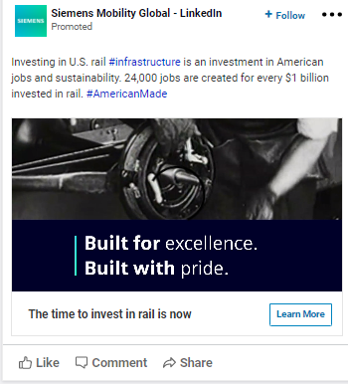
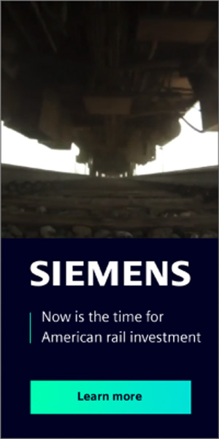
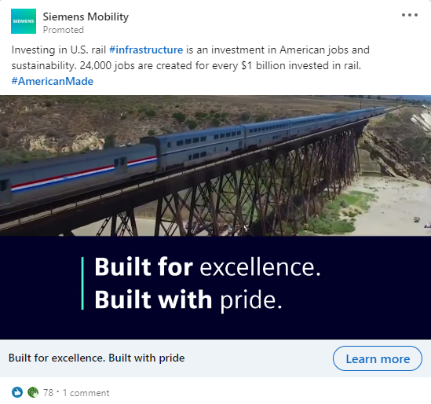
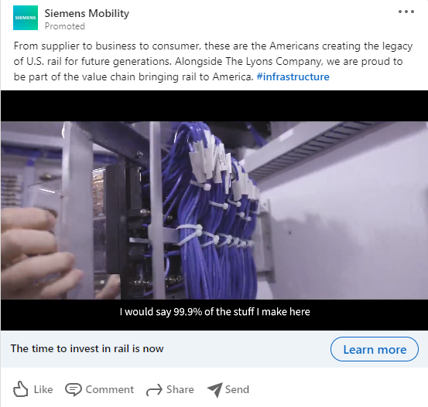
Paid media
Paid LinkedIn 15 sec Advert (same as programmatic)
Programmatic – HTML5 (15 sec video)
970x250 | 300x250 | 300x600 | 320x50
Politico syndicated article
3 million promotional impressions over 4 weeks
Paid LinkedIn – 4-part video series

Slide 7
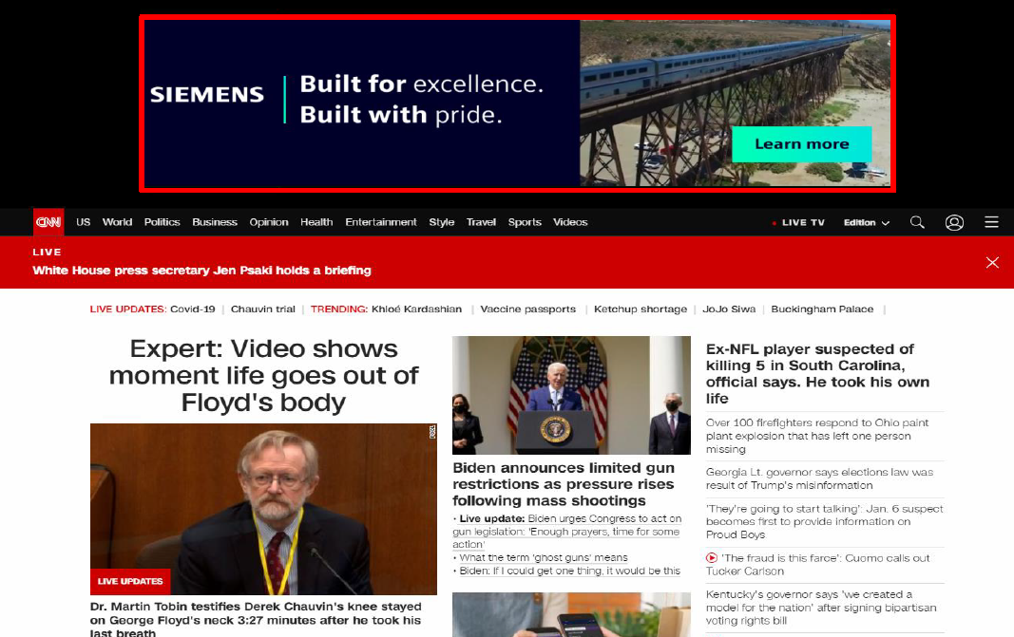
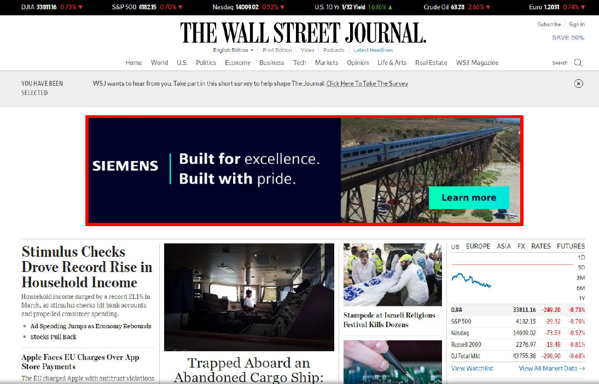
Programmatic
Over 550,000 impressions served on CNN with a 0.13% CTR
Premium Site List publisher 50% stronger CTR than Open Exchange.
Key transit executive's audience – 0.13% CTR vs. Government transportation decision makers – 0.09% CTR.
Notes:
Updated by Vanessa – June 8

Slide 8
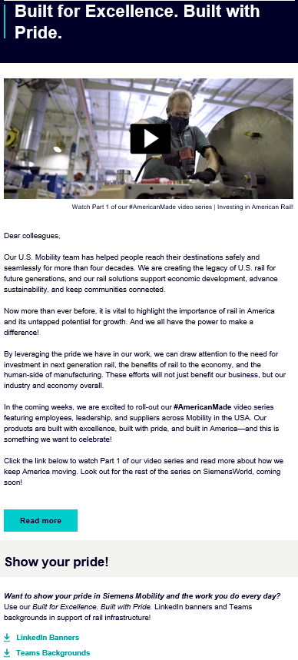
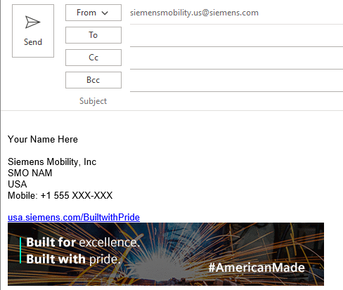
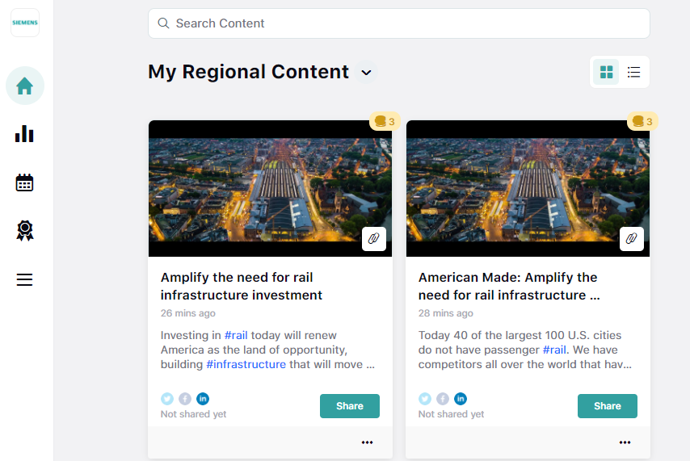
Employee Communications
Amplifying the voices of our greatest assets: our employees
Going beyond informing them with campaign… but engaging with them
Signature update
Letter to SMO US employees
Amplify 2.0
LinkedIn Banners & Teams Backgrounds
260 downloads
Siemens World Article
https://siemensworld.dc.siemens.com/2021/03/25/built-for-excellence-built-with-pride/

Slide 9
Campaign Links
Siemens Mobility Call to Action: - our press page featured a call to action for rail investment and housed relevant assets all in one place. This included a social media toolkit with pre-written posts and suggested hashtags, as well media downloads available. https://www.mobility.siemens.com/us/en/company/newsroom/press-releases/american-rail-investment-is-critical-for-economic-recovery.html
Siemens Mobility American Made webpage: https://www.mobility.siemens.com/us/en/trends/investing-in-american-rail.html?gclid=CjwKCAiA0KmPBhBqEiwAJqKK480ihTlrSTChDafPS4R_Z_ebhmZ2byBScigqDQ5Z5z3aeDi0DGzHsRoCTmkQAvD_BwE
Siemens Mobility Manufacturing in the USA webpage: https://www.mobility.siemens.com/us/en/company/locations.html
Politico Article: https://www.politico.com/sponsor-content/2021/04/19/the-next-rail-revolution-investing-in-american-rail-for-renewed-progress-and-prosperity
Marc Buncher Blog: https://www.mobility.siemens.com/us/en/insights/a-once-in-a-lifetime-investment-in-american-transportation-the-bipartisan-infrastructure-deal.html
American Made Video Series
Video 1: https://www.youtube.com/watch?v=DAXeR-NIT5Y
Video 2: https://www.youtube.com/watch?v=wnMoZMO406A
Video 3: https://www.youtube.com/watch?v=P0LZ5Fs0ins
Video 4: https://www.youtube.com/watch?v=QQgwIODAUhE
Notes:
Updated by Vanessa – June 8

