Slide 1
MCTS Develops Unique Human Trafficking Training and Bus Materials
2021 AWARENESS CAMPAIGN ON A SHOESTRING BUDGET

Slide 2
Bus Shelter Ads
Wisconsin ranks #3 in the country for human trafficking.
MCTS conducted research across several law enforcement agencies and nonprofits to understand how Milwaukee transit plays a role in prevention.
The research pointed to misconceptions about the victim and inaccurate stereotypes. Research also pointed to a lack of a call to action that’s straightforward for bus operators who can’t stop to access a list of national hotlines.
Through a partnership with Vector Media, MCTS was able to produce bus posters, bus shelter ads, and a simple operator instruction manual on a shoestring budget.

Slide 3
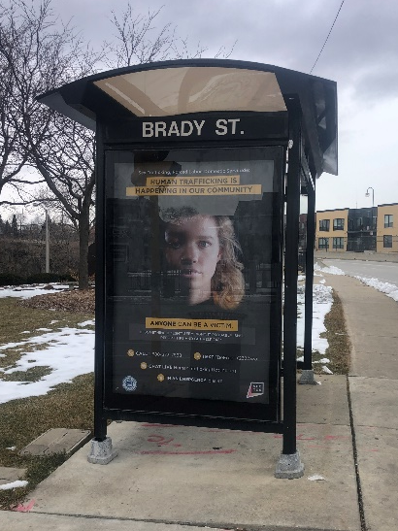
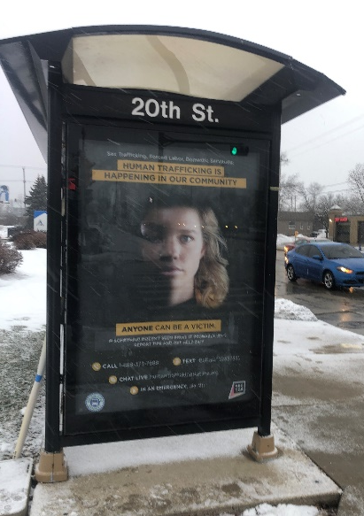
Bus Shelter Ads in the Community
The creative was designed in-house at MCTS
Campaign runs in January –which is National Slavery and Human Trafficking Prevention Month

Slide 4
Interior Bus Inserts – Close up of artwork

Slide 5
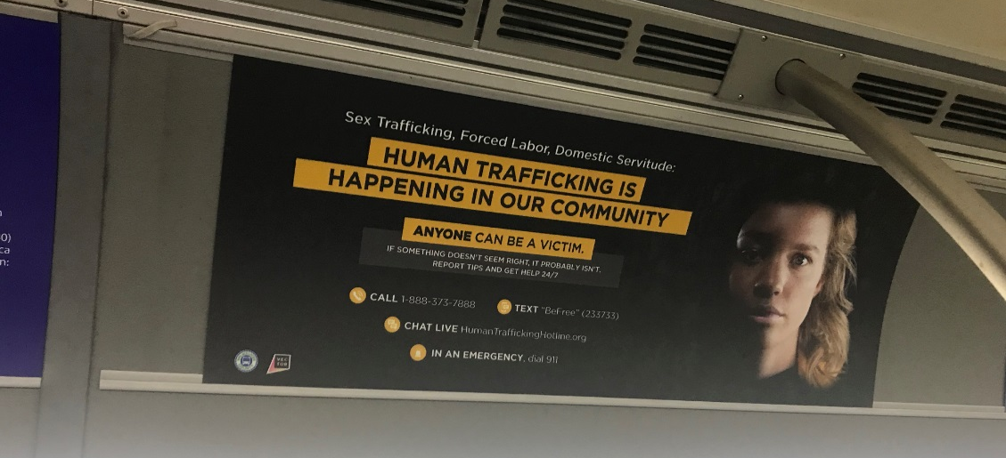
Interior Bus Inserts – Actual placement

Slide 6
Transit Insider
An e-newsletter went to stakeholders across Milwaukee which included council members, local nonprofits, and legislators to build awareness of who can be a victim.

Slide 7
Operator Training Guide
MCTS incorporated human trafficking prevention into ongoing operator training
MCTS developed a training booklet internally on a shoestring budget
A simple call to action made it easier for drivers to make a difference.

Slide 8
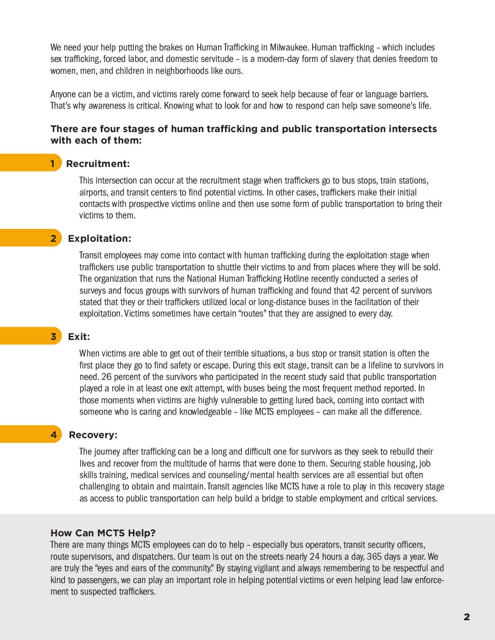
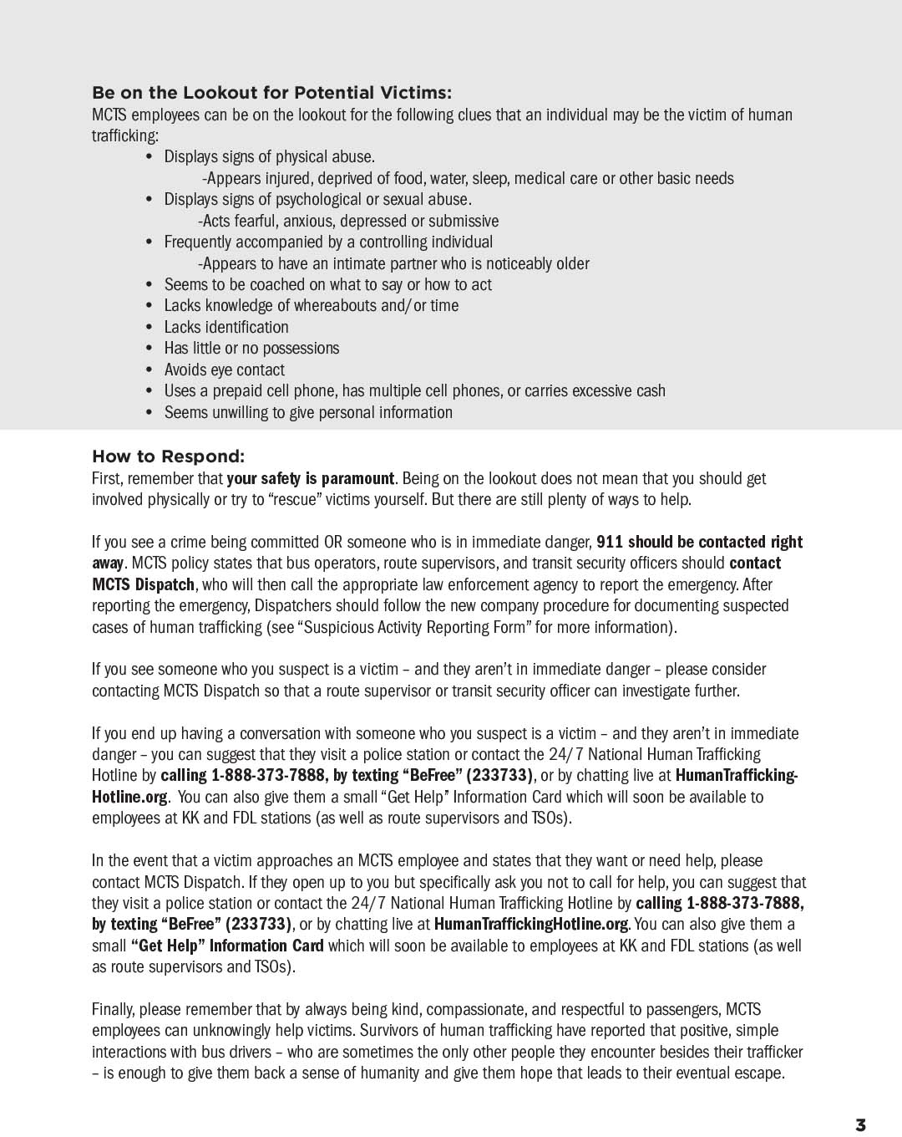
Operator Training Guide

Slide 9
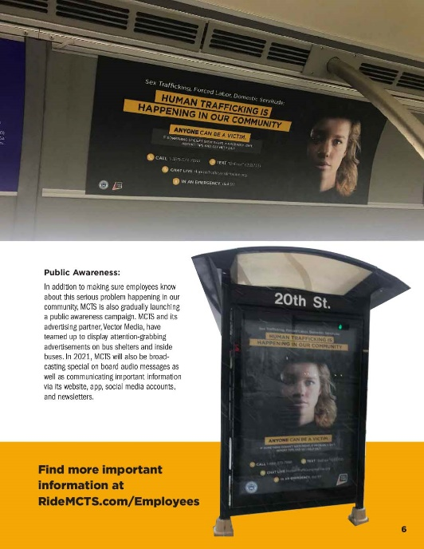
Operator Training Guide

