Slide 1
AdWheels Submission: Recruitment

Slide 2
Marketing Campaign Objectives
Increase awareness of the Coach Operator position
Drive job application submissions
Marketing Strategy
Use paid marketing channels to reach potential job candidates — both active and passive job seekers
Leverage bus driver recruitment personas to help drive creative messaging and targeting

Slide 3
Driver Job Applicant Personas

Slide 4
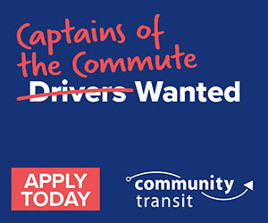
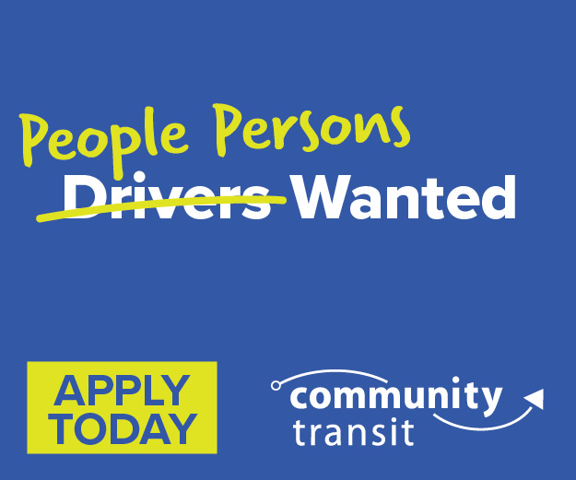
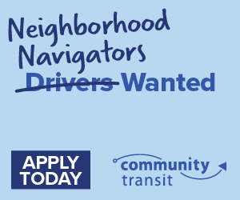
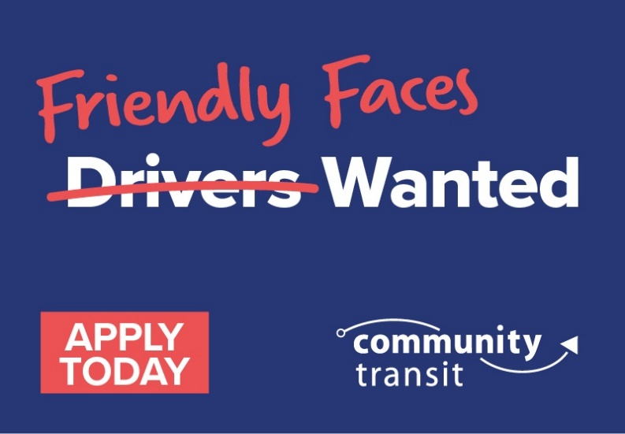
Campaign Creative

Slide 5
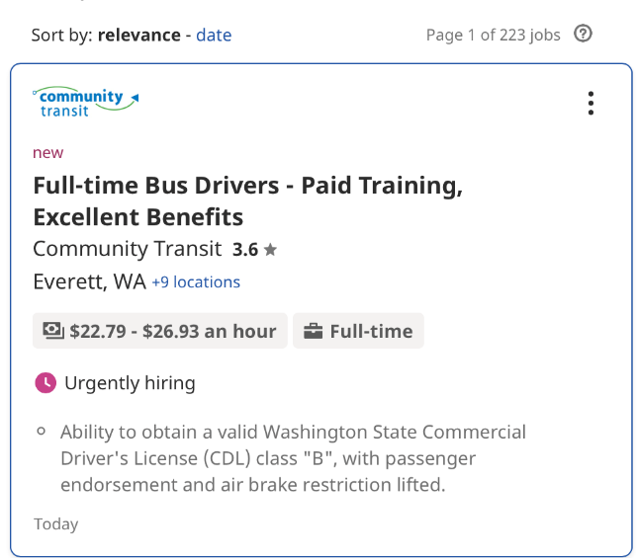
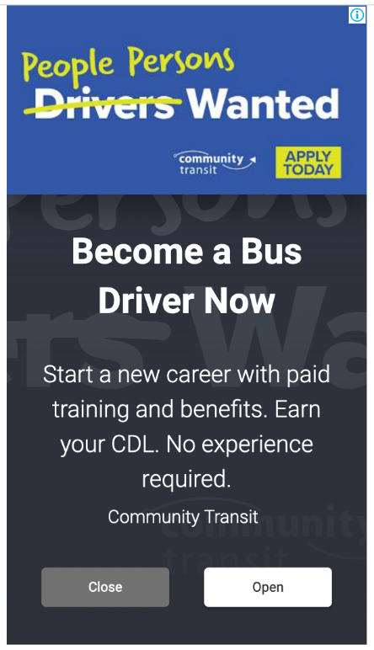
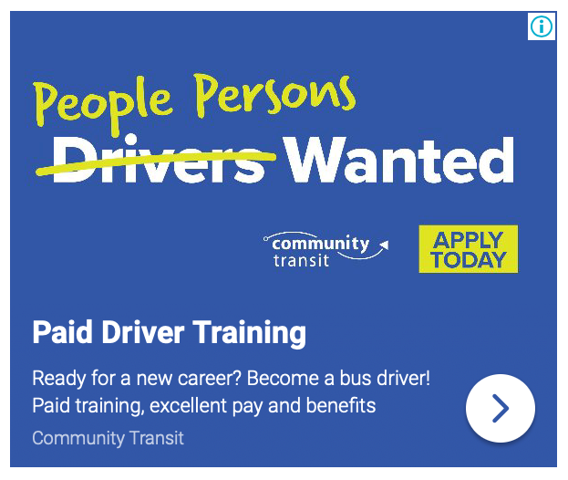
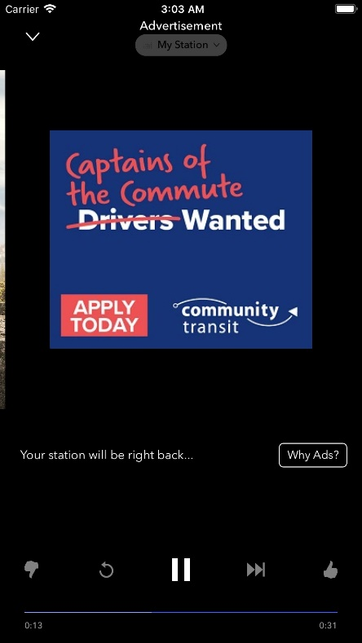
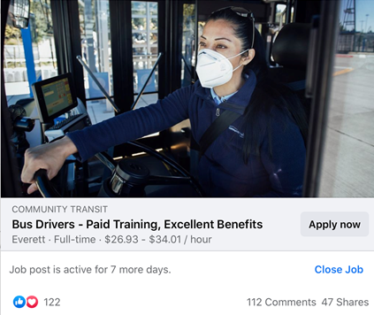
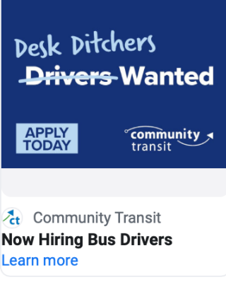
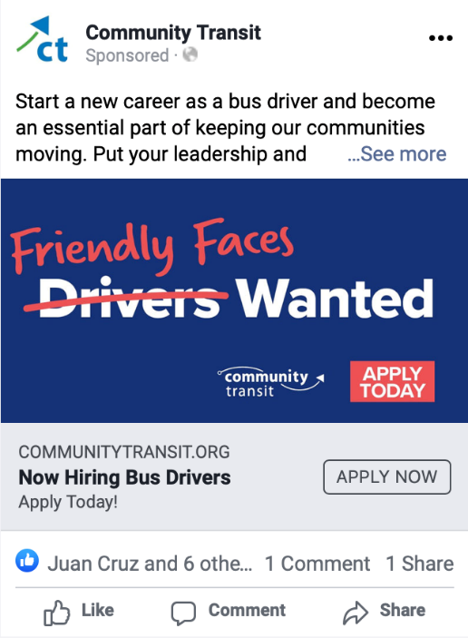
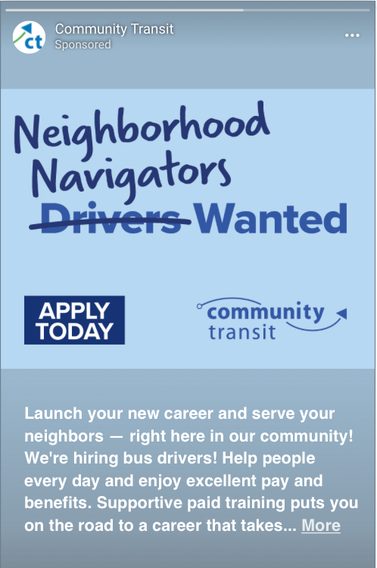
Marketing Tactics
Reaching Active Job Seekers
Job Boards
Sponsored Jobs
Paid Search
Reaching Passive Job Seekers
Paid Social
Digital Display
Streaming Video
Streaming Audio
Direct Mail

Slide 6
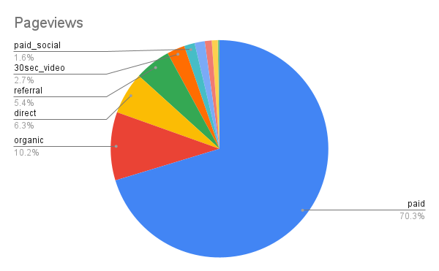
Bus Driver Landing Page Data
Increased engagement & interest
From Jan. 2021 to Feb. 10, 2022, more than 83.7% of pageviews were directly referred by our advertising.
From Jan, 2021 to Aug. 2021, 1,566 applications were started for our coach operator positions.
Our bus driver recruiting page had 74,756 visitors between Jan. 2021 and Feb. 10, 2022. That’s about of 2% of all website pageviews.
Our bus driver recruiting page was the 7th most visited page behind our homepage and trip-planning tools.

